Slide 1
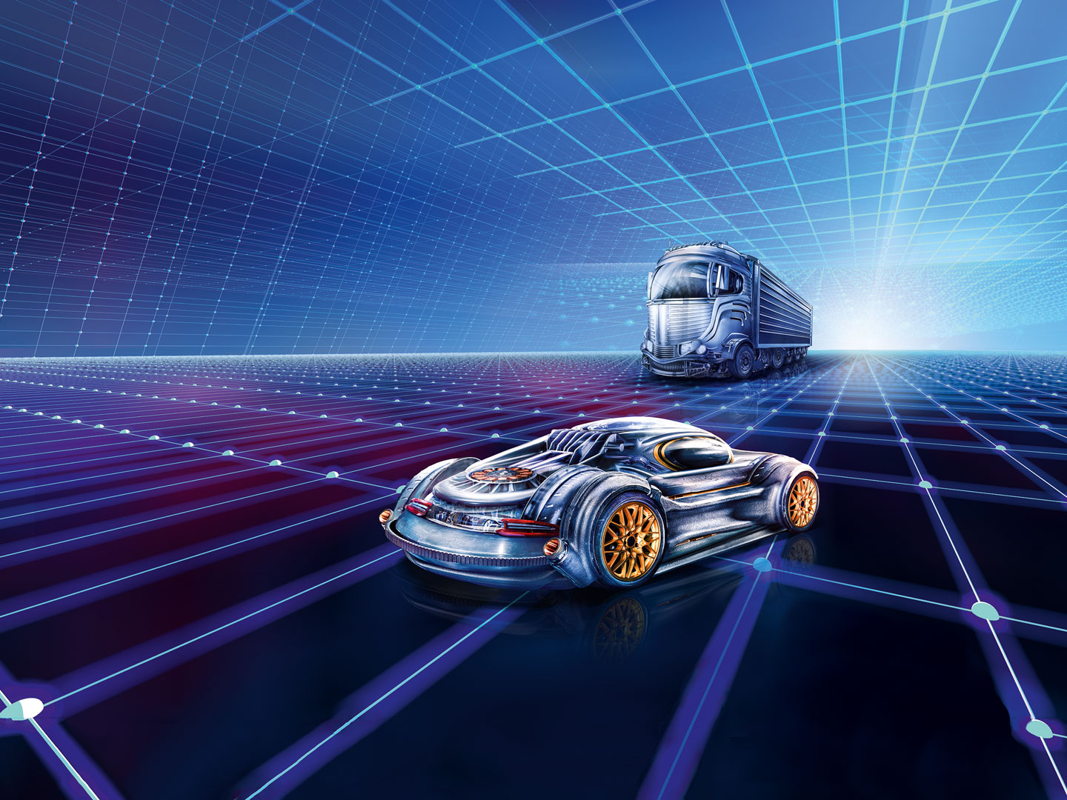

AUTOMECHANIKA INDIA
www.techsciresearch.com
MARKET INTELLIGENCE. CONSULTING

Slide 2
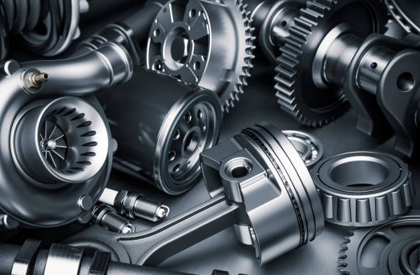
FY 2022
INDIA AUTOMOTIVE AFTERMARKET
www.techsciresearch.com
MARKET INTELLIGENCE. CONSULTING

Slide 3
India Automotive Aftermarket Share, By Part Type
India Automotive Aftermarket Share, By Part Type, By Value, FY2022
Other Includes:*Steering system hard parts, Remanufactured engine and transmission, remanufactured rack and pinion steering gear, Heating Ventilation and Air Conditioning (HVAC) and engine cooling components, light vehicle exhaust emission control systems, fuel-delivery systems, engine control units, ignition parts, automotive sensors, ignition wire sets, fuel pumps, selected automotive remanufactured pumps, sports compact underhood components, belt, hoses, gaskets and seals, battery, carburetor, gauge, and internal engine hard parts
Source: TechSci Research
Overall Aftermarket Value | USD 13.41 Billion

Slide 4
India Automotive Aftermarket Share, By Trade
India Automotive Aftermarket Share, By Trade, By Value, FY2022
Source: TechSci Research
India’s Automotive aftermarket was valued at USD 13.41 billion in FY 2022, including about USD 4.2 billion in imports.

Slide 5

MARKET DYNAMICS

Slide 6
Market Drivers
Focus on Reduced Emissions/Exhaust & Improved Fuel Consumption Technology by Component Manufacturers
The need for more fuel-efficient, automobiles has increased the demand for aftermarket components like electronic chips and catalytic converters. Owners' keen interest in upgrading their older vehicles with new features is a major factor in the expansion of the automotive aftermarket sector.
Original equipment manufacturers have continuously increased their level of engagement and attention within the automotive parts aftermarket value chain, OEMs have started distributing their parts directly to stores in order to improve customer engagement, cut down on counterfeit goods, and keep their brands at the forefront of the market. By utilizing vehicle connection, for example, to keep customers and automate service and repair decision-making, OEMs are also investing in customer experience optimization initiatives and developing differentiated aftermarket service options.
The aftermarket service is used to upgrade the existing automobiles with new parts or to repair a damaged item in a vehicle. Various parts of the clients' automobiles such as tires, batteries, lubricants need to be changed at predetermined intervals. For example, depending on driving conditions, passenger automobiles need to replace their tires every 3–4 years. Consequently, there is a sizable aftermarket for vehicle parts. Additionally, the aftermarket is expanding as a result of consumer preferences for installing cutting-edge automotive components to enhance vehicle look and ensure driver safety.
1
2
Direct reach by OEMs to Retailers
3
Replacement sales Growth Rate

Slide 7
Market Challenges
The phrase "counterfeit components" describes replicas of parts from well-known brands. The vendors don't follow the standards or employ a uniform testing technique, even though that the parts are supplied in the unorganized sector under brand names. This creates a big barrier in the Indian aftermarket. A few manufacturers have developed parts with holographic sealing in response to the problem of counterfeit components.
The highly distributed Indian service network ecology is dominated by independent workshops. The IAM is facing a variety of difficulties, such as developing the necessary infrastructure, enhancing skill sets to accommodate contemporary technologies, and gaining technical expertise, which contains concerns about the caliber of services. There is also lack in availability of parts of old vehicle models due to lack of supply chain also with increasingly modern cars, this issue will result in more OES channel alternatives.
The rise in pricing issues is occurring more frequently as new players (Tier 1 and Tier 2 companies) enter the market and keep component prices much lower than Tier 1 companies. As a result, Tier 1 players are finding it extremely challenging to meet their sales goals and are primarily focused on supplying OEMs. Customers in India prioritise cost above quality, thus they choose to purchase counterfeit parts over high-quality products. Owing to these reasons, the aftermarket is anticipated to face some fascinating effects of this shift in the automotive industry.
Pe
Lacking Substantial Product Availability on Regular Basis
Aftermarket Counterfeit Parts and the Unorganized Sector
Competitive Pricing Issue

Slide 8

MARKET TRENDS AND DEVELOPMENTS

Slide 9
Market Trends and Developments
Improvising in Product development Capabilities
To meet the quality product standard, companies are expanding their spending in establishing up R&D operations and laboratories to execute tasks like analysis, simulation, and engineering animations. Additionally, the expansion of global OEM sourcing from India over the past several years and the increasing indigenization of global OEMs are making the nation a desirable location for designing and manufacturing. Nitin Gadkari, Minister of Road Transport and Highways, requested that flex-fuel vehicle production begin within the next six months in December 2021. ZF, a prominent manufacturer of German automotive components, opened and extended its new Tech centre in India in June 2022.In March 2022, Minister of State for Power and Heavy Industries Mr. Krishan Pal Gurjar, said that Indian and foreign automobile manufacturers have taken initiatives to develop hydrogen fuel cell vehicles.
1
Growing Popularity of E-commerce Platform
The lack of domestically produced items, low prices, market participants' consumer-focused targeting, and higher-quality goods have all contributed to the expansion of the e-commerce sector. Additionally, e-commerce enables OEMs with a chance to sell their goods directly to customers, relieving them of the troublesome supply chain, and provides SMEs with numerous benefits for business growth and globalization. Global utilization of the e-commerce logistics sector will increase as the rising country's index of digital service acceptance rises. An international indicator called the "Digital Service Adoption Index" tracks how many sectors of society—including business, government, and the general public—have adopted digital technology. Organizations can thrive in a world where technology is widely used thanks to the efficiency and connectivity that digital technologies offer.
2
Rise in Investment
Alliance Tire Group (ATG), a manufacturer of off-highway tires owned by the Yokohama Group of Japan, revealed intentions to construct its third facility in the nation in Visakhapatnam in September 2020. The project is expected to cost USD 165 Million (Rs. 1,240 crore). According to Mr. Soumitra Bhattacharya, managing director of Bosch Ltd, the manufacturer of auto components, plans to invest more than USD 25.12 million Rs. 200 crore in India over the next five years in the fields of advanced automotive technologies and digital mobility. Also, German Auto component major ZF has doubled down on India with an investment of USD 214.10 Billion.
3

Slide 10
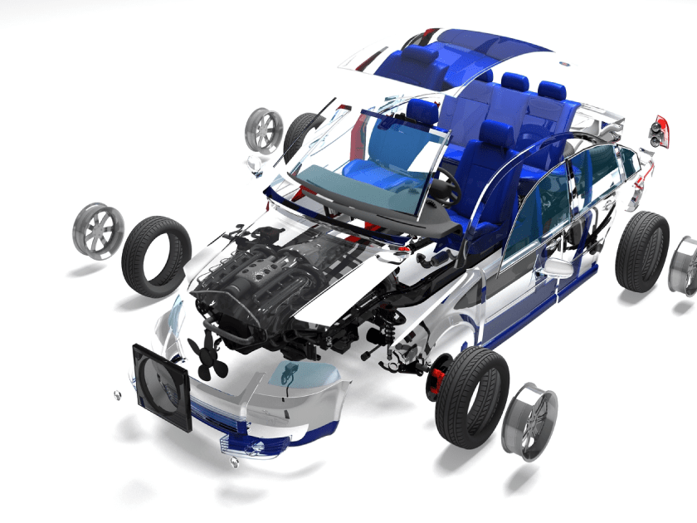
PRODUCT BENCHMARKING

Slide 11
Product Benchmarking
Key Products Import Analysis:
Product | Reporting Country | Prominent Importing Country
Brakes | India | Germany, China, South Korea, United States, Italy
Tires | India | Thailand, China, Indonesia, Malaysia, Vietnam, Japan
Lubricants | India | United States, Singapore, China, Germany, France
Batteries | India | China, Thailand., Sweden, Vietnam, United States, Japan
Filter | India | Japan, China, France, South Korea, Singapore, Germany
Starter/Alternators | India | China, Indonesia, Japan, South Korea, Thailand, Germany
Spark Plugs | India | China, Thailand, Japan, Vietnam, South Korea
Lighting | India | China, South Korea, Japan, Germany, Phillipines
Source: TechSci Research

Slide 12
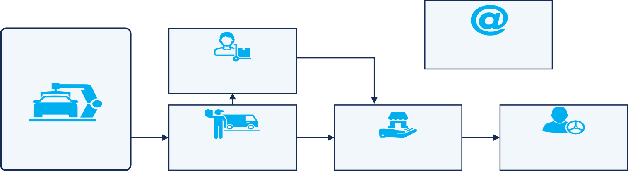
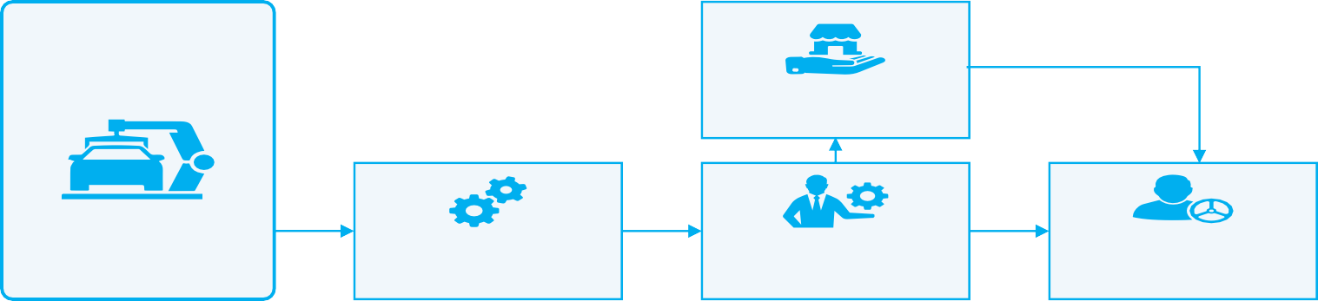
Parts Manufacturers
eRetailers
Wholesalers
IAM
Distributors
Retailers
Installers/ Vehicle Owners
Parts Manufacturers
ASC
OES
OEM
OE
Dealers
Installers/ Vehicle Owners
Direct eRetail
12

